Slide 1

Software Construction and Development

Slide 2
Today’s Agenda
Introduction to the Course
Objectives of the course
Basic Concepts

Slide 3
Course Introduction
Course Title: Software Construction & Dev
Total Credits: 2+1 Credits
Pre-requisite: Software Design & Architecture

Slide 4
Classroom Code
dng2ek4

Slide 5
Course Learning Outcomes
CLO 1:Understand the role of design and its major activities within the OO software development process.
CLO 2:Develop Object-oriented design models and refine them to reflect implementation details
CLO 3:Understand bad and good code practices

Slide 6
Recommended BOOKS
Code Complete 2nd edition: A practical handbook of software construction, published by Microsoft Press, 2004
Clean Code by Robert C Martin
Software Engineering by Ian Sommerville

Slide 7
Grading scheme
Quizess-10%
Assignments -10%
Presentation-5%
Mids-25%
Finals-50%

Slide 8
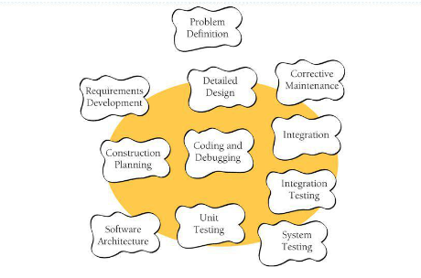
Software Development
Developing computer software can be a complicated process, and in the last 25 years, researchers have identified numerous distinct activities that go into software development. They include
■ Problem definition
■ Requirements development
■ Construction planning
■ Software architecture, or high-level design
■ Detailed design
■ Coding and debugging
■ Unit testing
■ Integration
■ System testing
■ Maintenance
Notes:
Software Crisis:1960

Slide 9
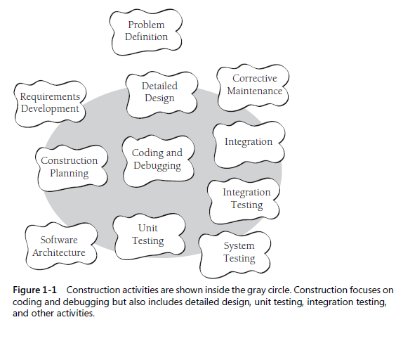
SOFTWARE CONSTRUCTION ACTIVITIES

Slide 10
Software cOnstruction
As the figure indicates, construction is mostly coding and debugging but also involves detailed design, construction planning, unit testing, integration, integration testing, and other activities.
Notes:
Construction is also sometimes known as “coding” or “programming.” “Coding” isn’t
really the best word because it implies the mechanical translation of a preexisting
design into a computer language; construction is not at all mechanical and involves
substantial creativity and judgment. Throughout the book, I use “programming” interchangeably
with “construction.”

Slide 11
Software construction
Here are some of the specific tasks involved in construction:
Verifying that the groundwork has been laid so that construction can proceed successfully
■ Determining how your code will be tested
■ Designing and writing classes and routines
■ Creating and naming variables and named constants
■ Selecting control structures and organizing blocks of statements
■ Unit testing, integration testing, and debugging your own code
■ Reviewing other team members’ low-level designs and code and having them review yours
■ Polishing code by carefully formatting and commenting it
■ Integrating software components that were created separately
■ Tuning code to make it faster and use fewer resources

Slide 12
Why Software Construction is IMPORTANT
Construction is a large part of software development
Construction is the central activity in software development
With a focus on construction, the individual programmer’s productivity can improve enormously
Construction’s product, the source code, is often the only accurate description of the software
Construction is the only activity that’s guaranteed to be done
Notes:
1. construction typically takes 30 to 80 percent of the total time spent on a
project. Anything that takes up that much project time is bound to affect the success
of the project.
2. Requirements and architecture are done before construction so that you can do construction effectively.
System testing (in the strict sense of independent testing) is done after construction
to verify that construction has been done correctly.
3. With a focus on construction, the individual programmer’s productivity can improve
Enormously. Sackman, Erikson, and Grant

Slide 13
Introduction
The term software construction refers to the detailed creation of working software through a combination of coding, verification, unit testing, integration testing, and debugging.
Quality (or lack thereof) is very evident in the construction products
Construction highly related to Computer Science due to
Use of algorithms
Detailed coding practices

Slide 14
Software Construction Fundamentals
Minimizing complexity
Anticipating change
Constructing for verification
Reuse
Standards in software construction

Slide 15
Minimizing Complexity
Humans are severely limited in our ability to hold complex information in our working memories
As a result, minimizing complexity is one the of strongest drivers in software construction
Need to reduce complexity throughout the lifecycle
As functionality increases, so does complexity

Slide 16
Minimizing Complexity
Accomplished through use of standards
Examples:
UML for modeling all aspects of complex systems
High-order programming languages such as C++ and Java
Source code formatting rules to aid readability

Slide 17
Anticipating Change
Software changes over time
Anticipation of change affect how software is constructed
This can effect
Handling of errors
Source code organization
Code documentation
Coding standards

Slide 18
Constructing for verification
Construct software that allows bugs to be easily found and fixed
Examples:
Enforce coding standards
Helps support code reviews
Unit testing
Organizing code to support automated testing
Restricted use of complex or hard-to-understand language structures
Notes:
Code reviews are methodical assessments of code designed to identify bugs, increase code quality, and help developers learn the source code.

Slide 19
Reuse
Reuse refers to using existing assets in solving different problems.
In software construction, typical assets that are reused include libraries, modules, components, source code..
Reuse is best practiced systematically, according to a well-defined, repeatable process.
Systematic reuse can enable significant software productivity, quality, and cost improvements.

Slide 20
Standards in Construction
Standards which directly affect construction issues include:
Programming languages
E.g. standards for languages like Java and C++
Communication methods
E.g. standards for document formats and contents
Platforms
Tools
E.g. diagrammatic standards for notations like the Unified Modeling Language
Notes:
C++ is commonly used in embedded systems, 3D and visual design programs, game development and building operating systems or web browsers and portals. Python is a scripting language that is better being used in machine learning contexts, data analysis and backend web development

Slide 21
Key Construction decisions
Every programming language has strengths and weaknesses. Be aware of the specific strengths and weaknesses of the language you’re using.
Establish programming conventions before you begin programming. It’s nearly impossible to change code to match them later.
More construction practices exist than you can use on any single project. Consciously choose the practices that are best suited to your project.
Ask yourself whether the programming practices you’re using are a response to the Your position on the technology wave determines what approaches will be effective— or even possible. Identify where you are on the technology wave, and adjust your plans and expectations accordingly.
Notes:
Chapter 4-Key Construction Decisions . .

Slide 22
home TASK
Exploring any recent research article related to the software construction and summarize in your own words.

